Slide 1
Garvis Pool repair
By tuesdayone
Featuring: Haley ovenhouse, Jeffrey fleurent, david murad, edgar meruvia & juan gomez
Notes:
Juan 1

Slide 2
Overview
CLIENT: Garvis Pool Repair
PROBLEM: Garvis Pool Repair company is currently running on a pen and paper system that does not allow for easy communication within the business.
SOLUTION: Create a mobile application that all employees use to manage operations across the company.
Client Registry – Client’s name, address, email address, homeowner notes, & work order history.
Work Order - Attached client, assigned employee, day & time of appointment, job description, quoted price, and completion button.
Schedule - Displays the work orders by day and time.
Notes:
Jeffrey 1

Slide 3
Team member Roles
Team Lead: Haley Ovenhouse
Database Lead: David Murad
Backend Lead: Jeffrey Fleurent
Version Control: Edgar Meruvia
UX/UI Lead: Juan Gomez
Notes:
Haley 1

Slide 4
LOC: 20,000+ lines of code from Java and XML
CLASSES & METHODS:
23 Java Classes
100+ methods
TECHNOLOGIES USED:
Android Studio - Java
FireBase – noSQL
GoogleMaps API
HOURS SPENT:
Coding: 120+ hours
Research: 60+ hours
Time w/ client: 5+ hours
Documentation: 12+ hours
TOTAL: 197+ hours
SEMESTER EFFORTS
Notes:
Edgar 1

Slide 5
Video
https://www.youtube.com/watch?v=xriybanyV8M&feature=youtu.be
Notes:
David

Slide 6
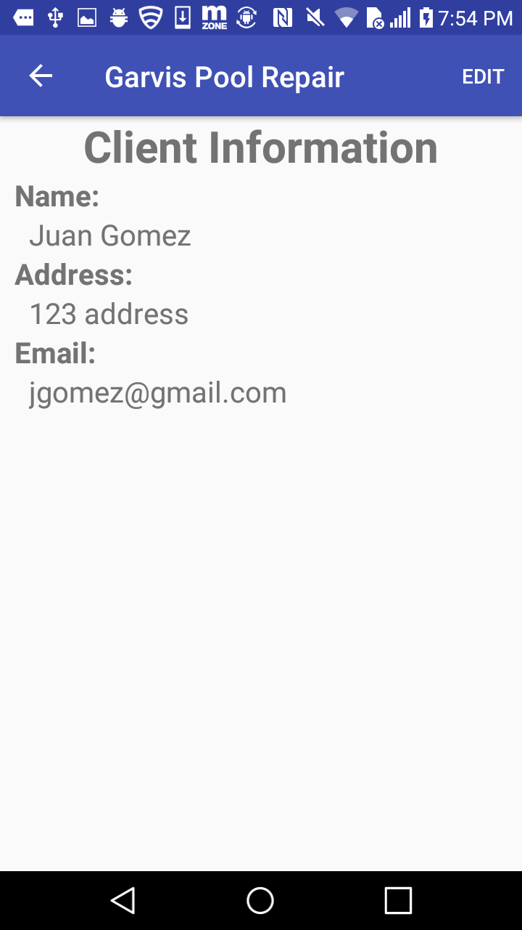
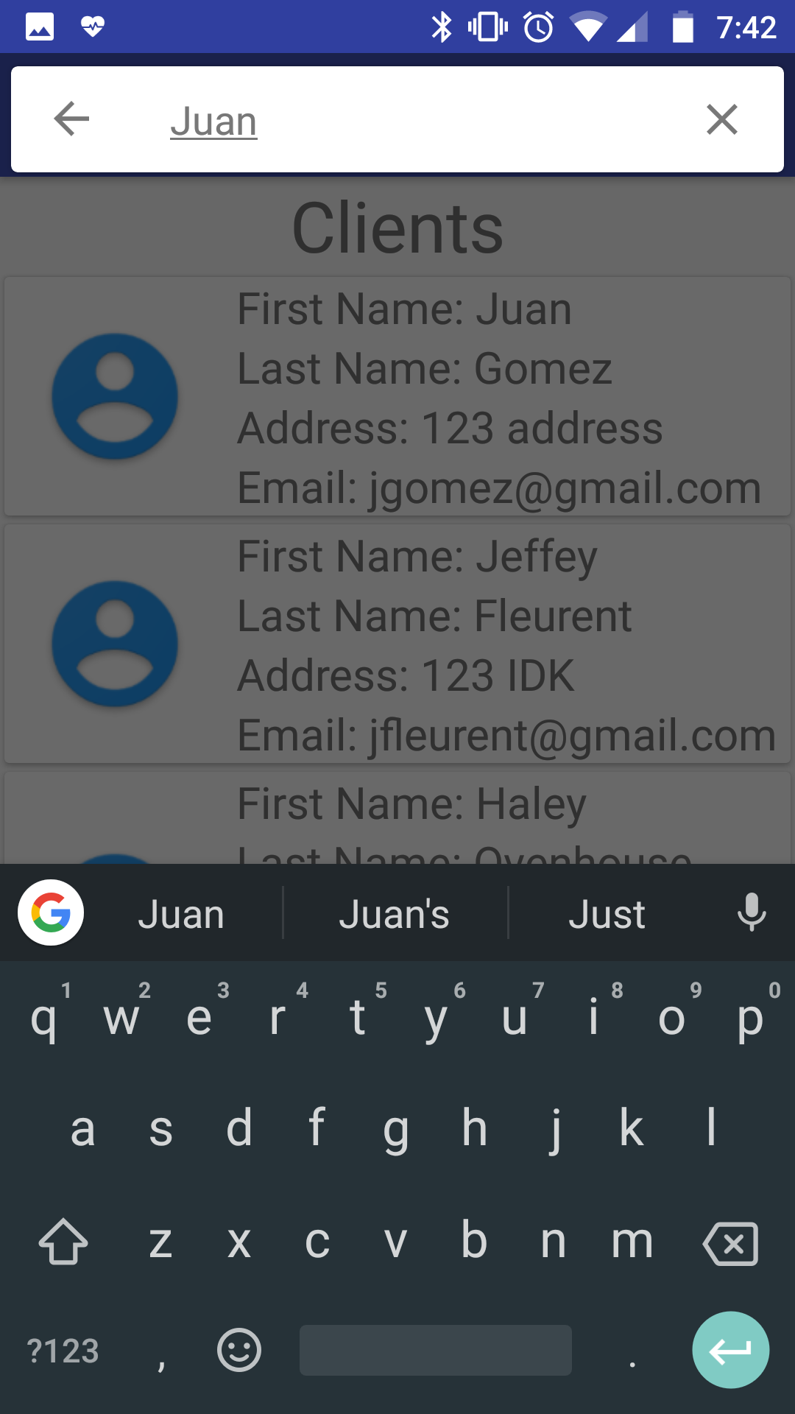
Test Results
Search Bar
Search bar functionality does not work as we would have liked for it to.
Originally wanted search bar to search through clients and work orders to filter them.
Did not get implemented due to difficulties with querying data base to search for anything containing what is in the text field.
Would like to have implemented in future versions when we have better understanding of the data base.
Lacks address validation
When entering an address when creating a client, there is no validation to make sure that the address actually exists.
This can create issues with the GoogleMaps API when the address does not actually exist, it gives a very random location.
Notes:
Juan 2

Slide 7
LEGACY
Challenges
Setting up the database
Designing the app
Creating the functionality
Connecting UI component of the app
Learned Along the way
Use of various UI components
Use of Firebase
Google Maps API
Acquiring requirements from clients
Reflection
Should have planned better on the design of the app.
Done more research on what type of database to use before working on the app.
Manage time better
Notes:
Jeffrey 2

Slide 8
Thank You!
&
Questions?
Notes:
Haley 2

Slide 9
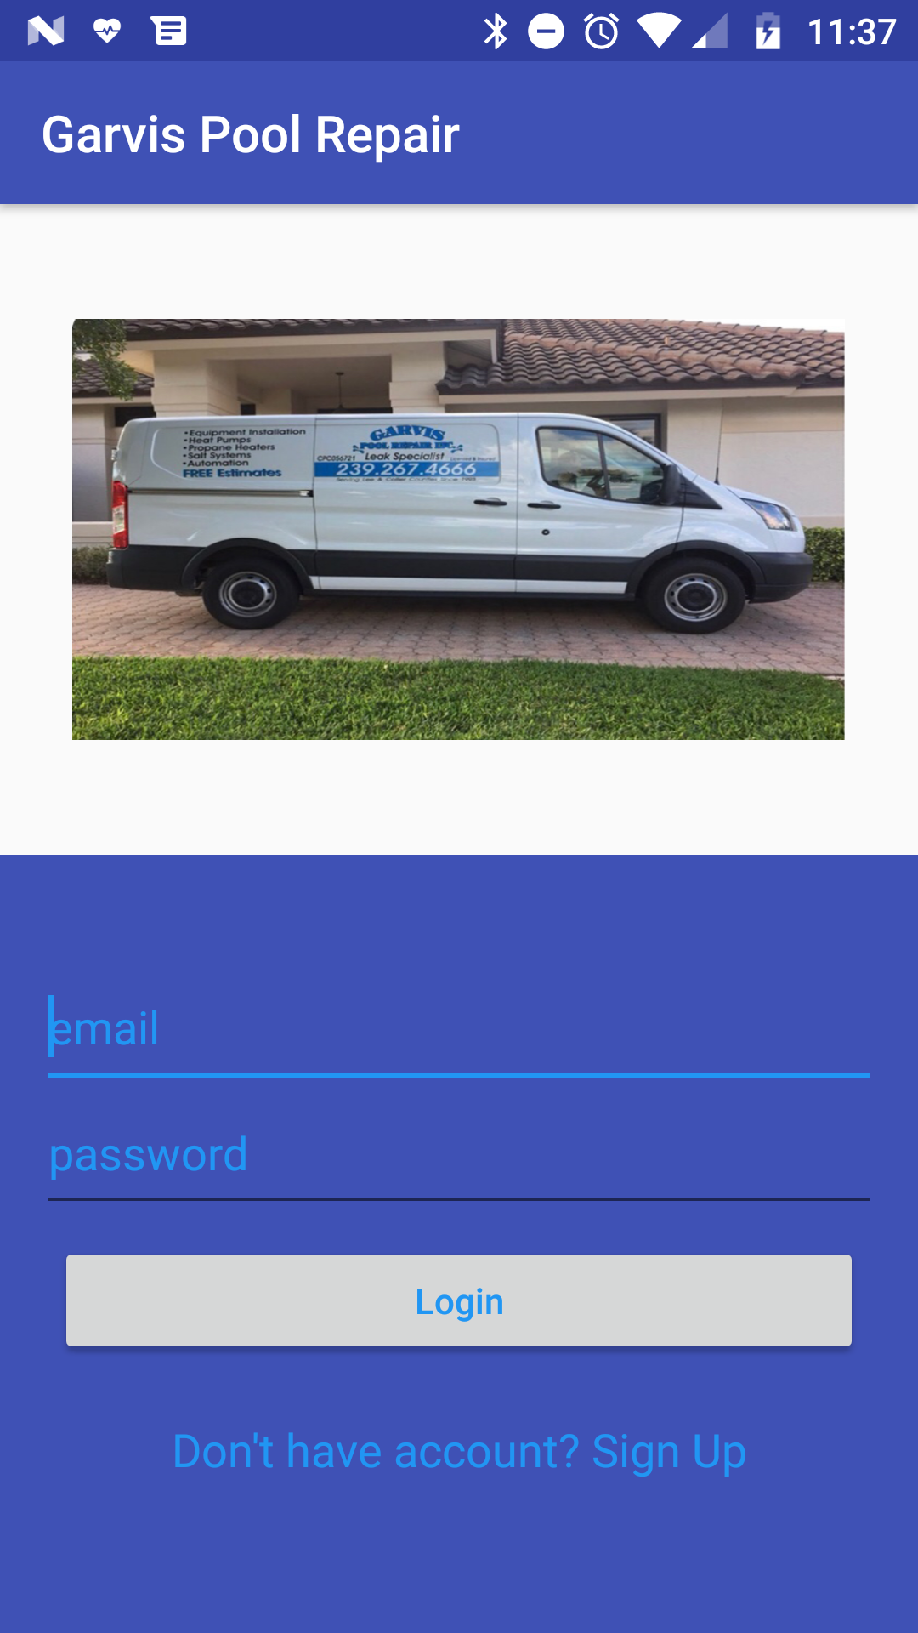
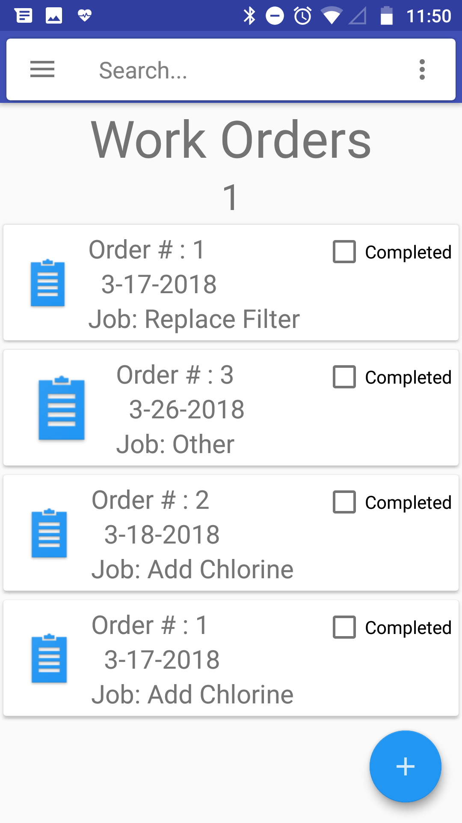
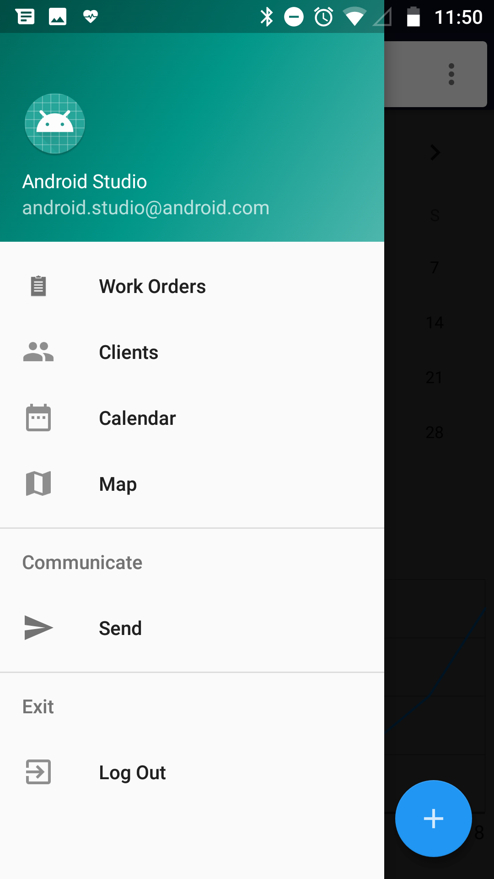
Screenshots
Notes:
Juan

Slide 10
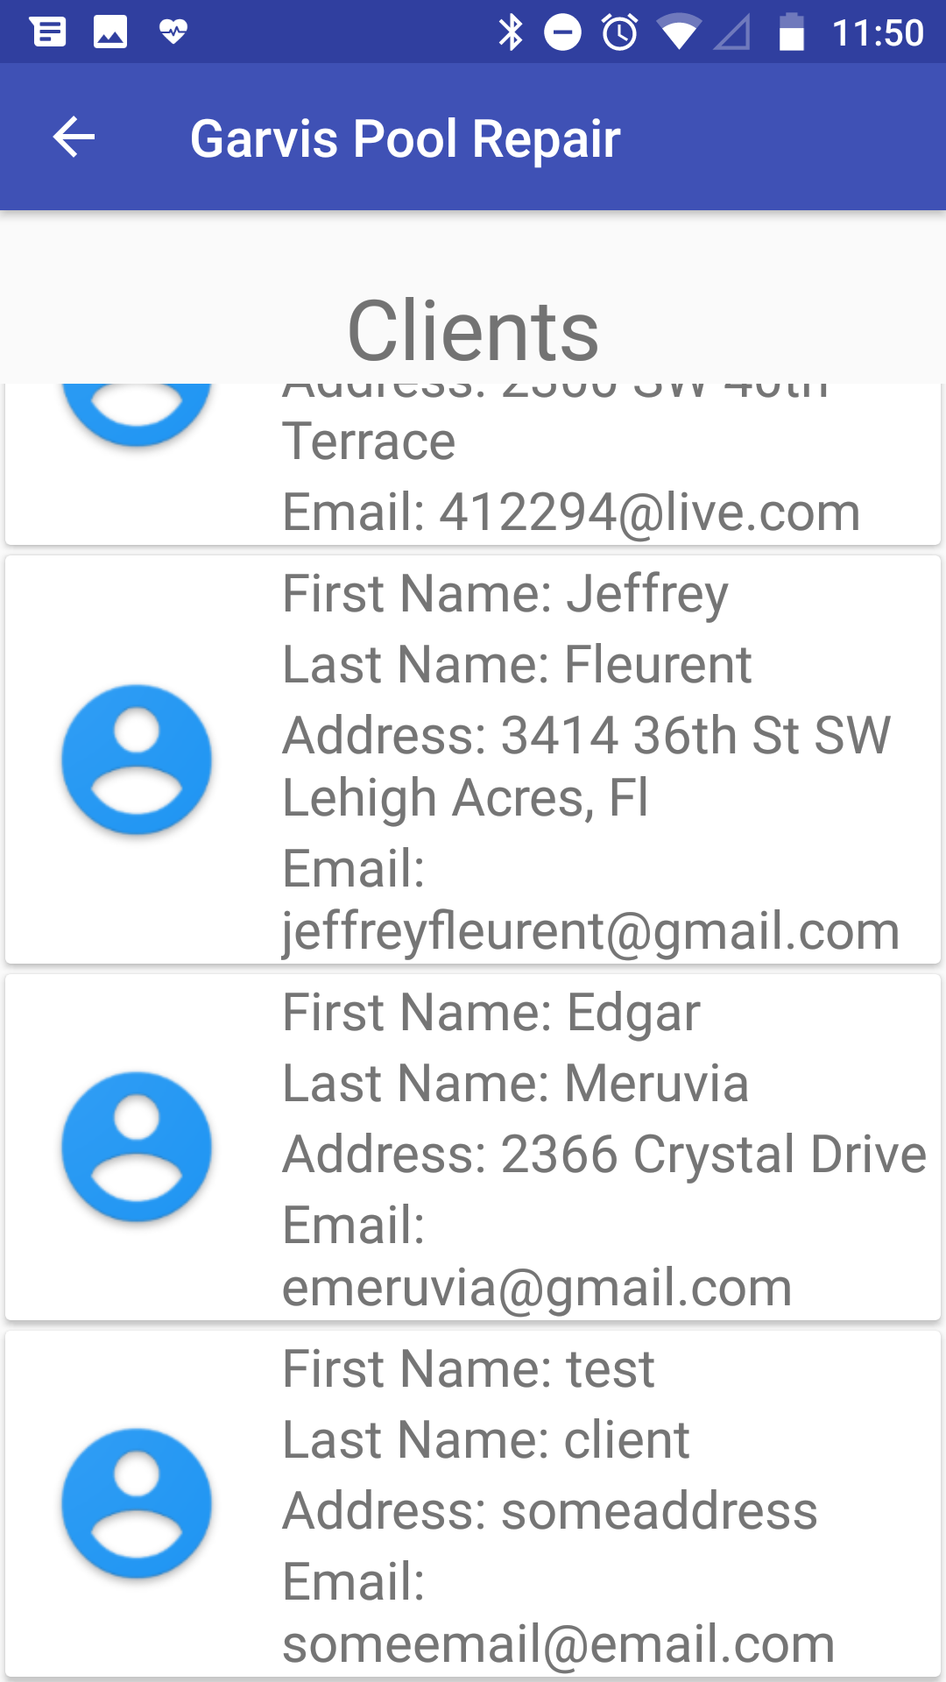
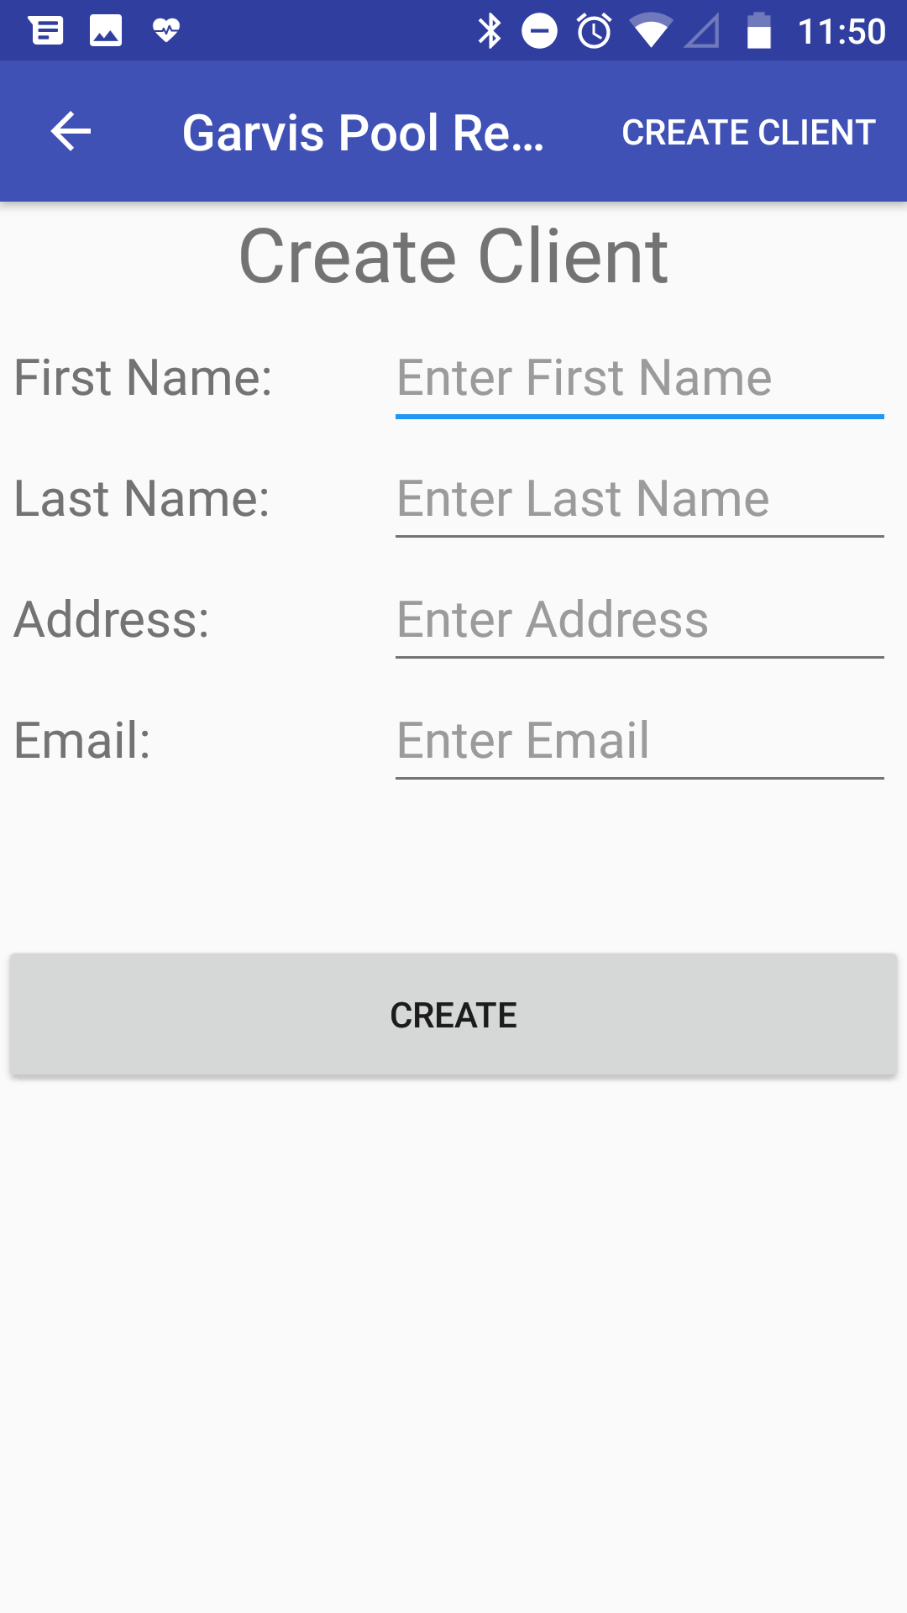
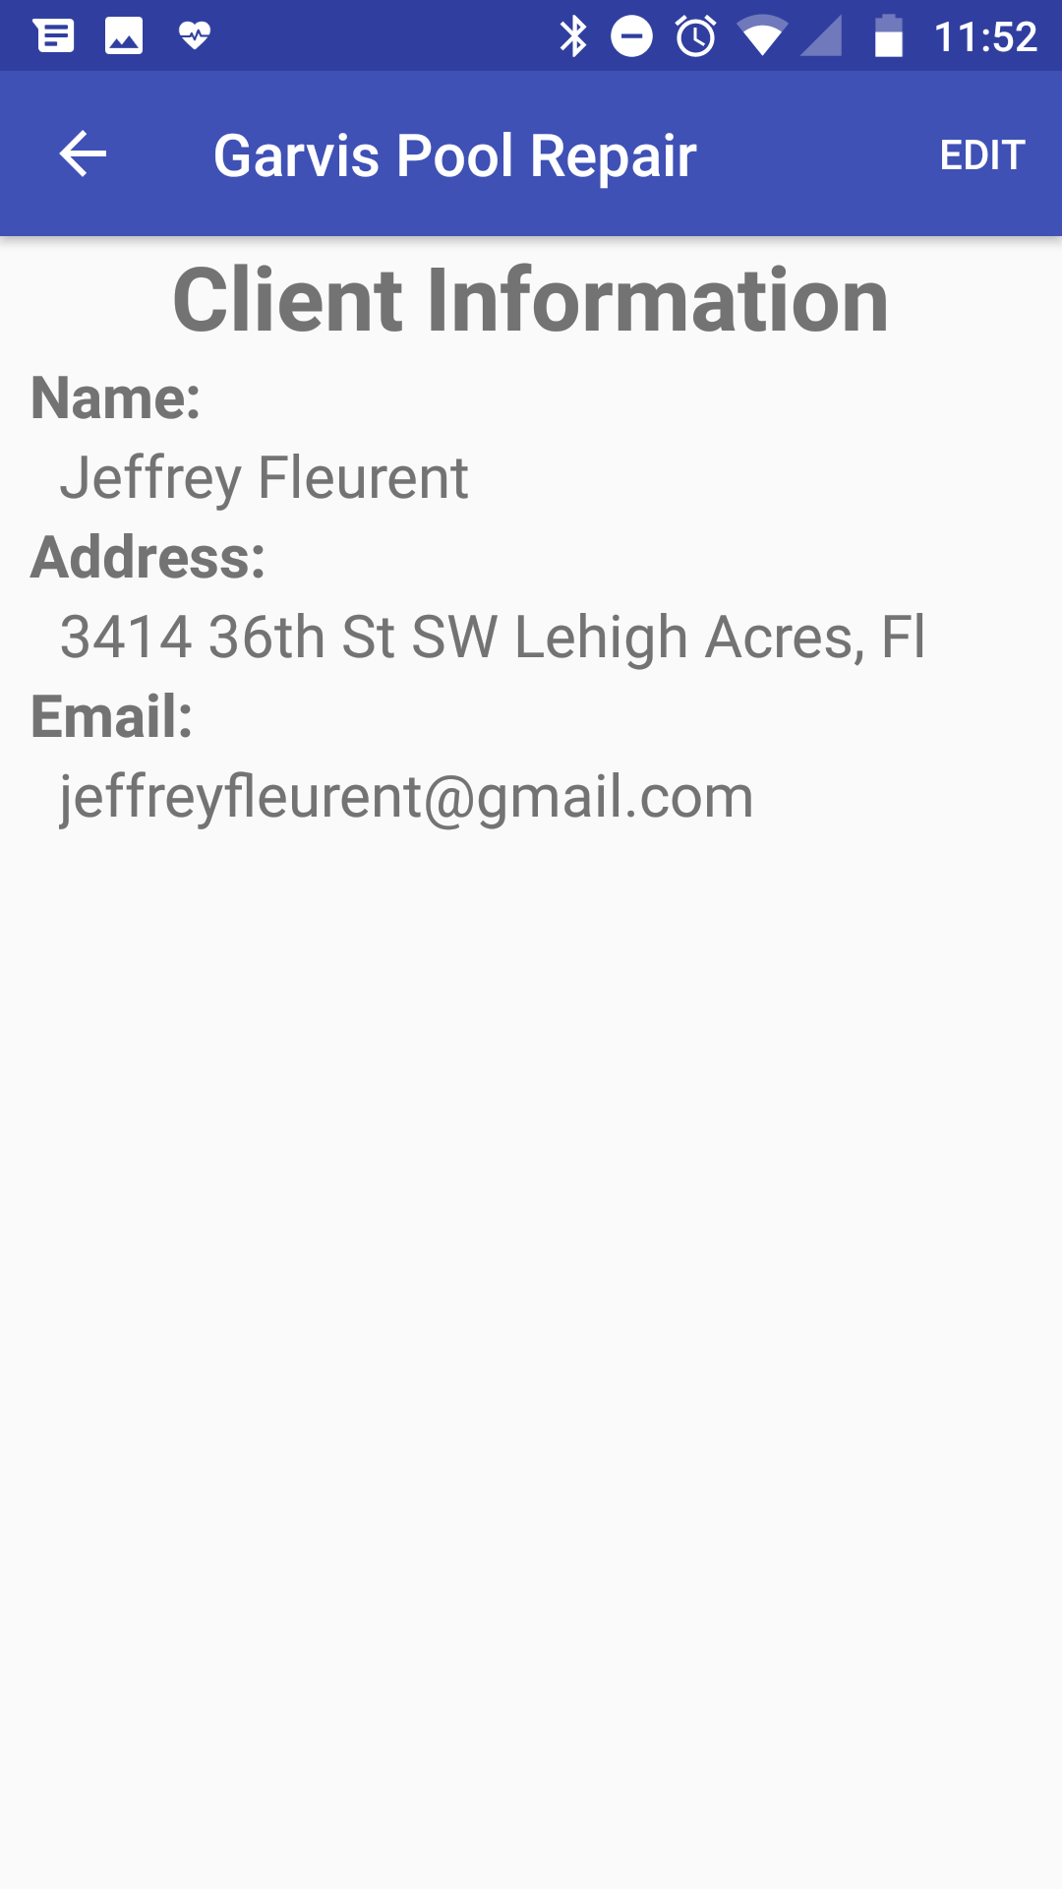
Screenshots
Notes:
Juan

Slide 11
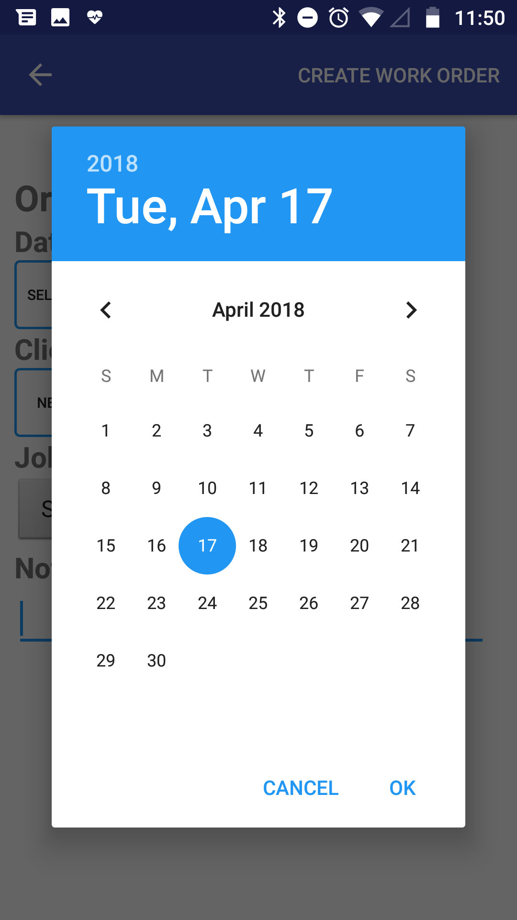
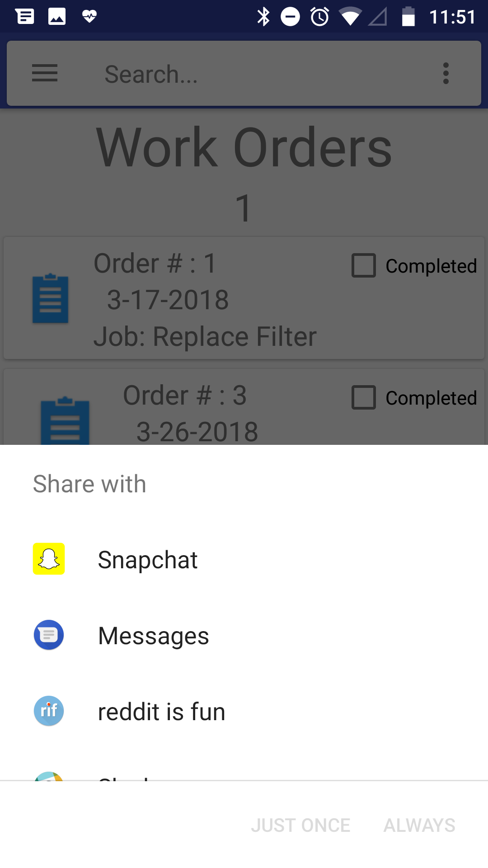
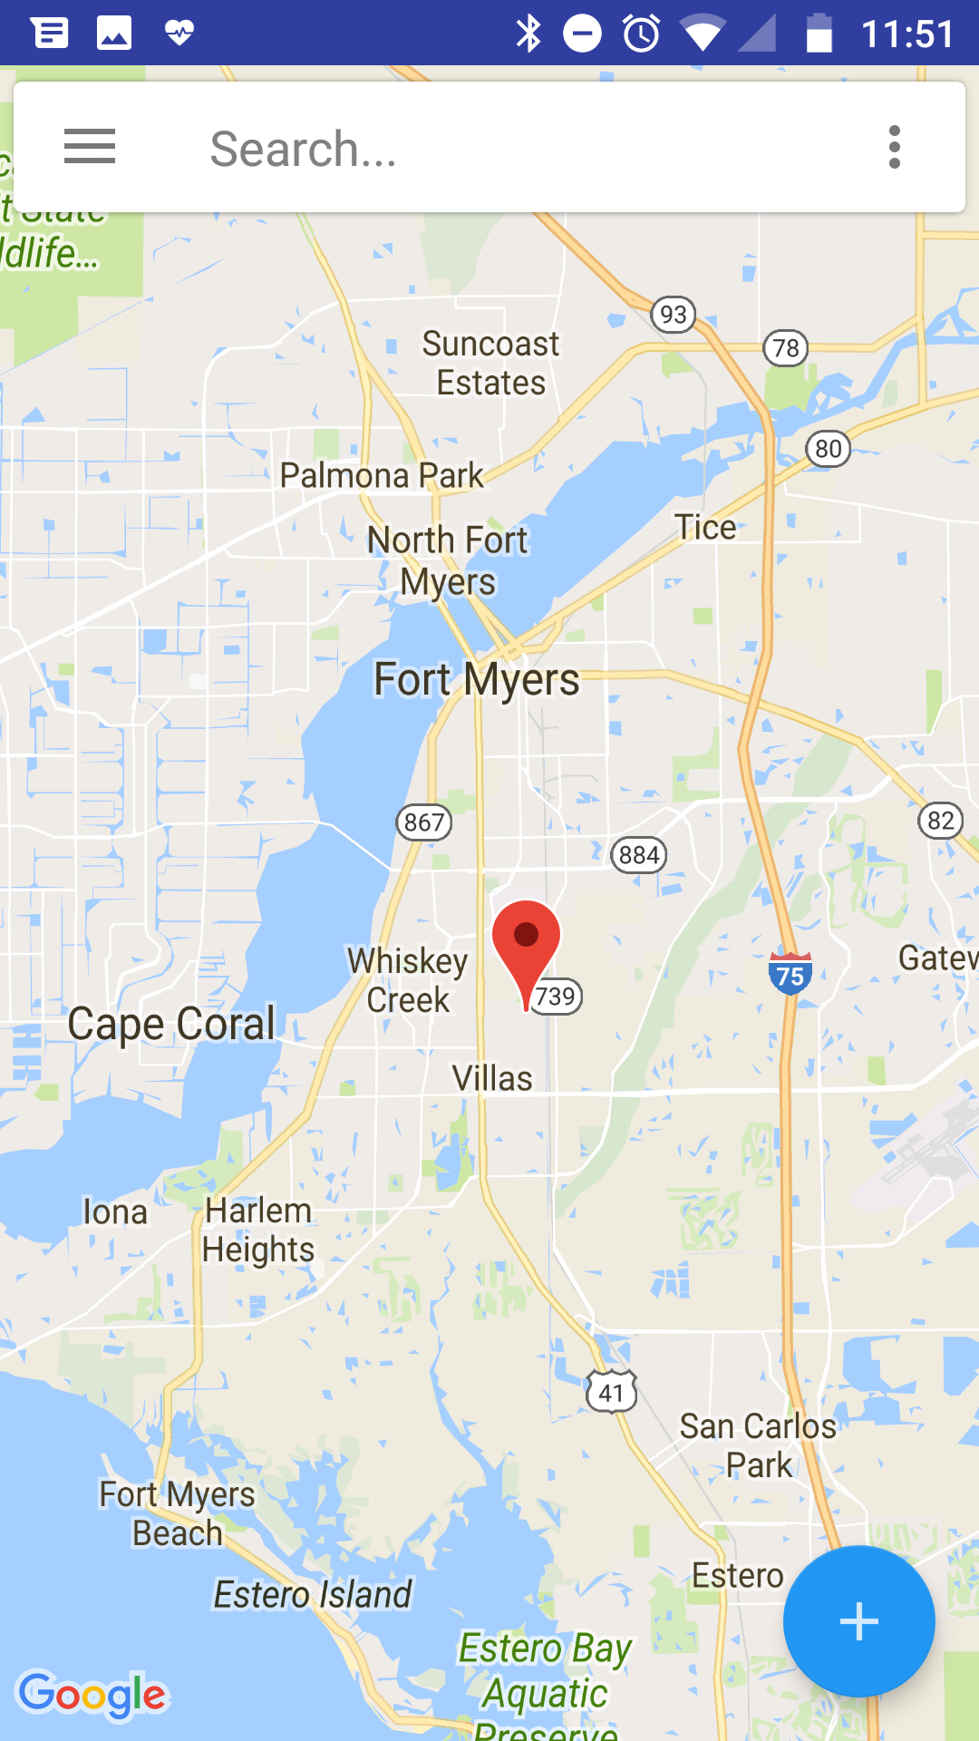
Screenshots
Notes:
Juan

